Slide 1
Lab 7: Visualizing Android Sensor Data in AWS
Sufyan Shaikh
Charles Andre

Slide 2
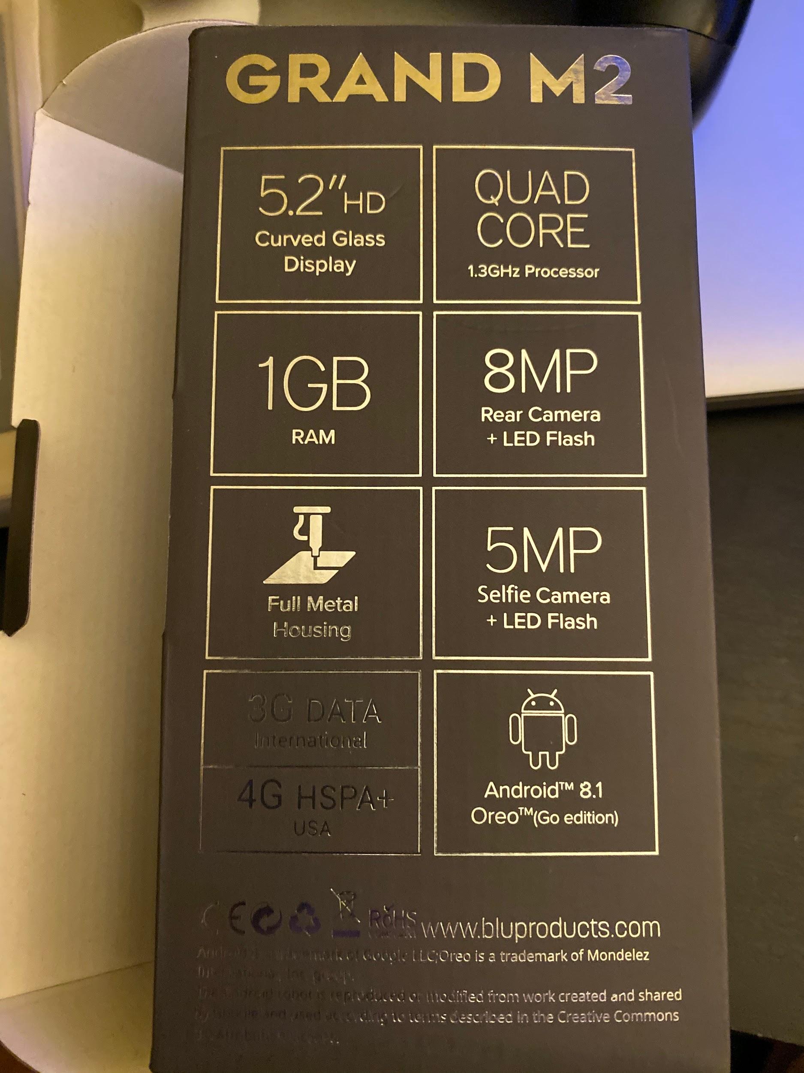
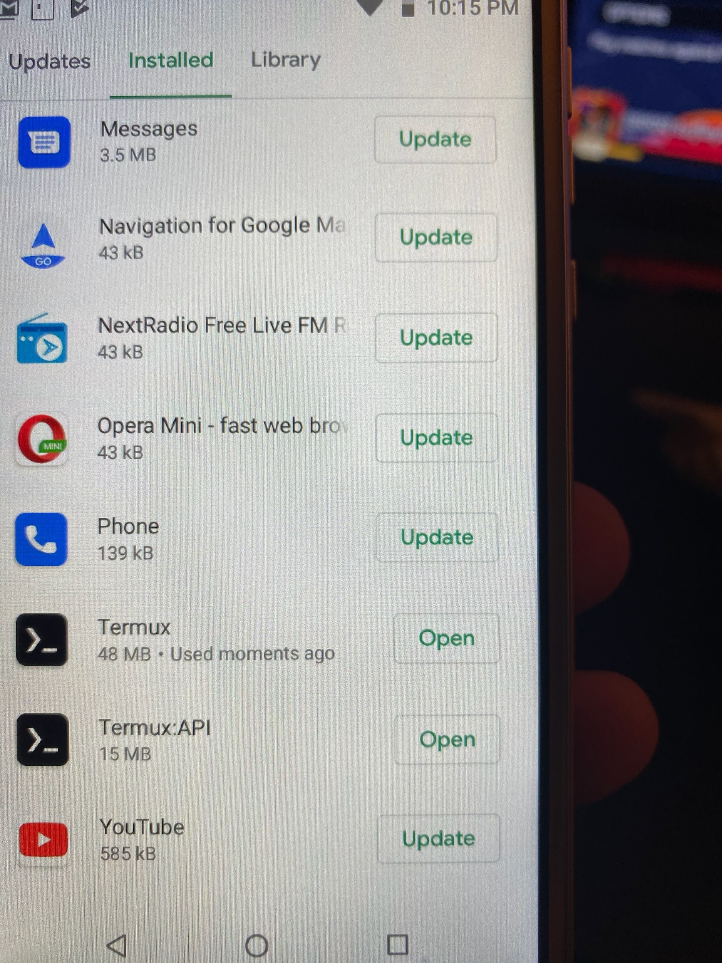
Step 1
→ Buy an Android Phone, we bought one at BestBuy.
→ Setup the Android Phone and install Termux and Termux API from the Google Play store.

Slide 3
Step 2
→ Install node-red on to your android on the Termux app using the following commands.
apt update
apt upgrade
apt install termux-api
apt install coreutils nodejs
npm i -g --unsafe-perm node-red

Slide 4
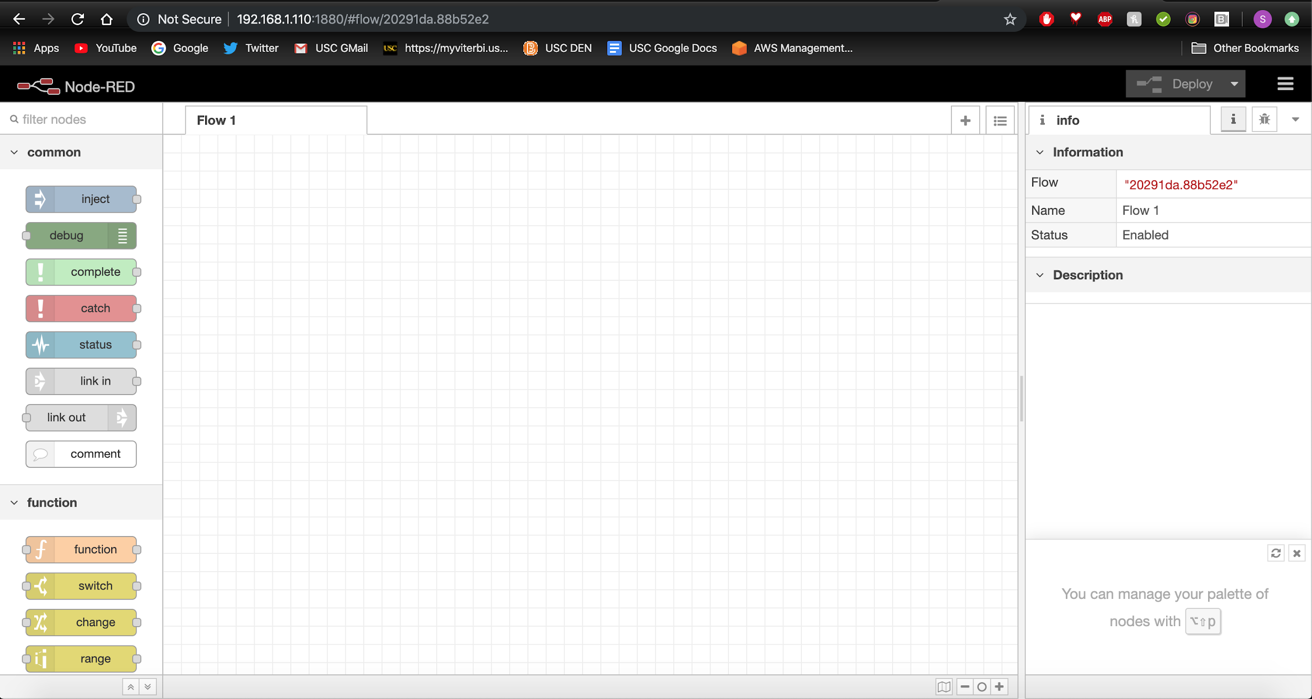
Step 3
→ Launch Node-Red on your Android phone!
Node-red
→ It is accessible on your Laptop if you are connected to the same wifi by heading to “http://[IP_ADDR_PHONE]:1880”

Slide 5
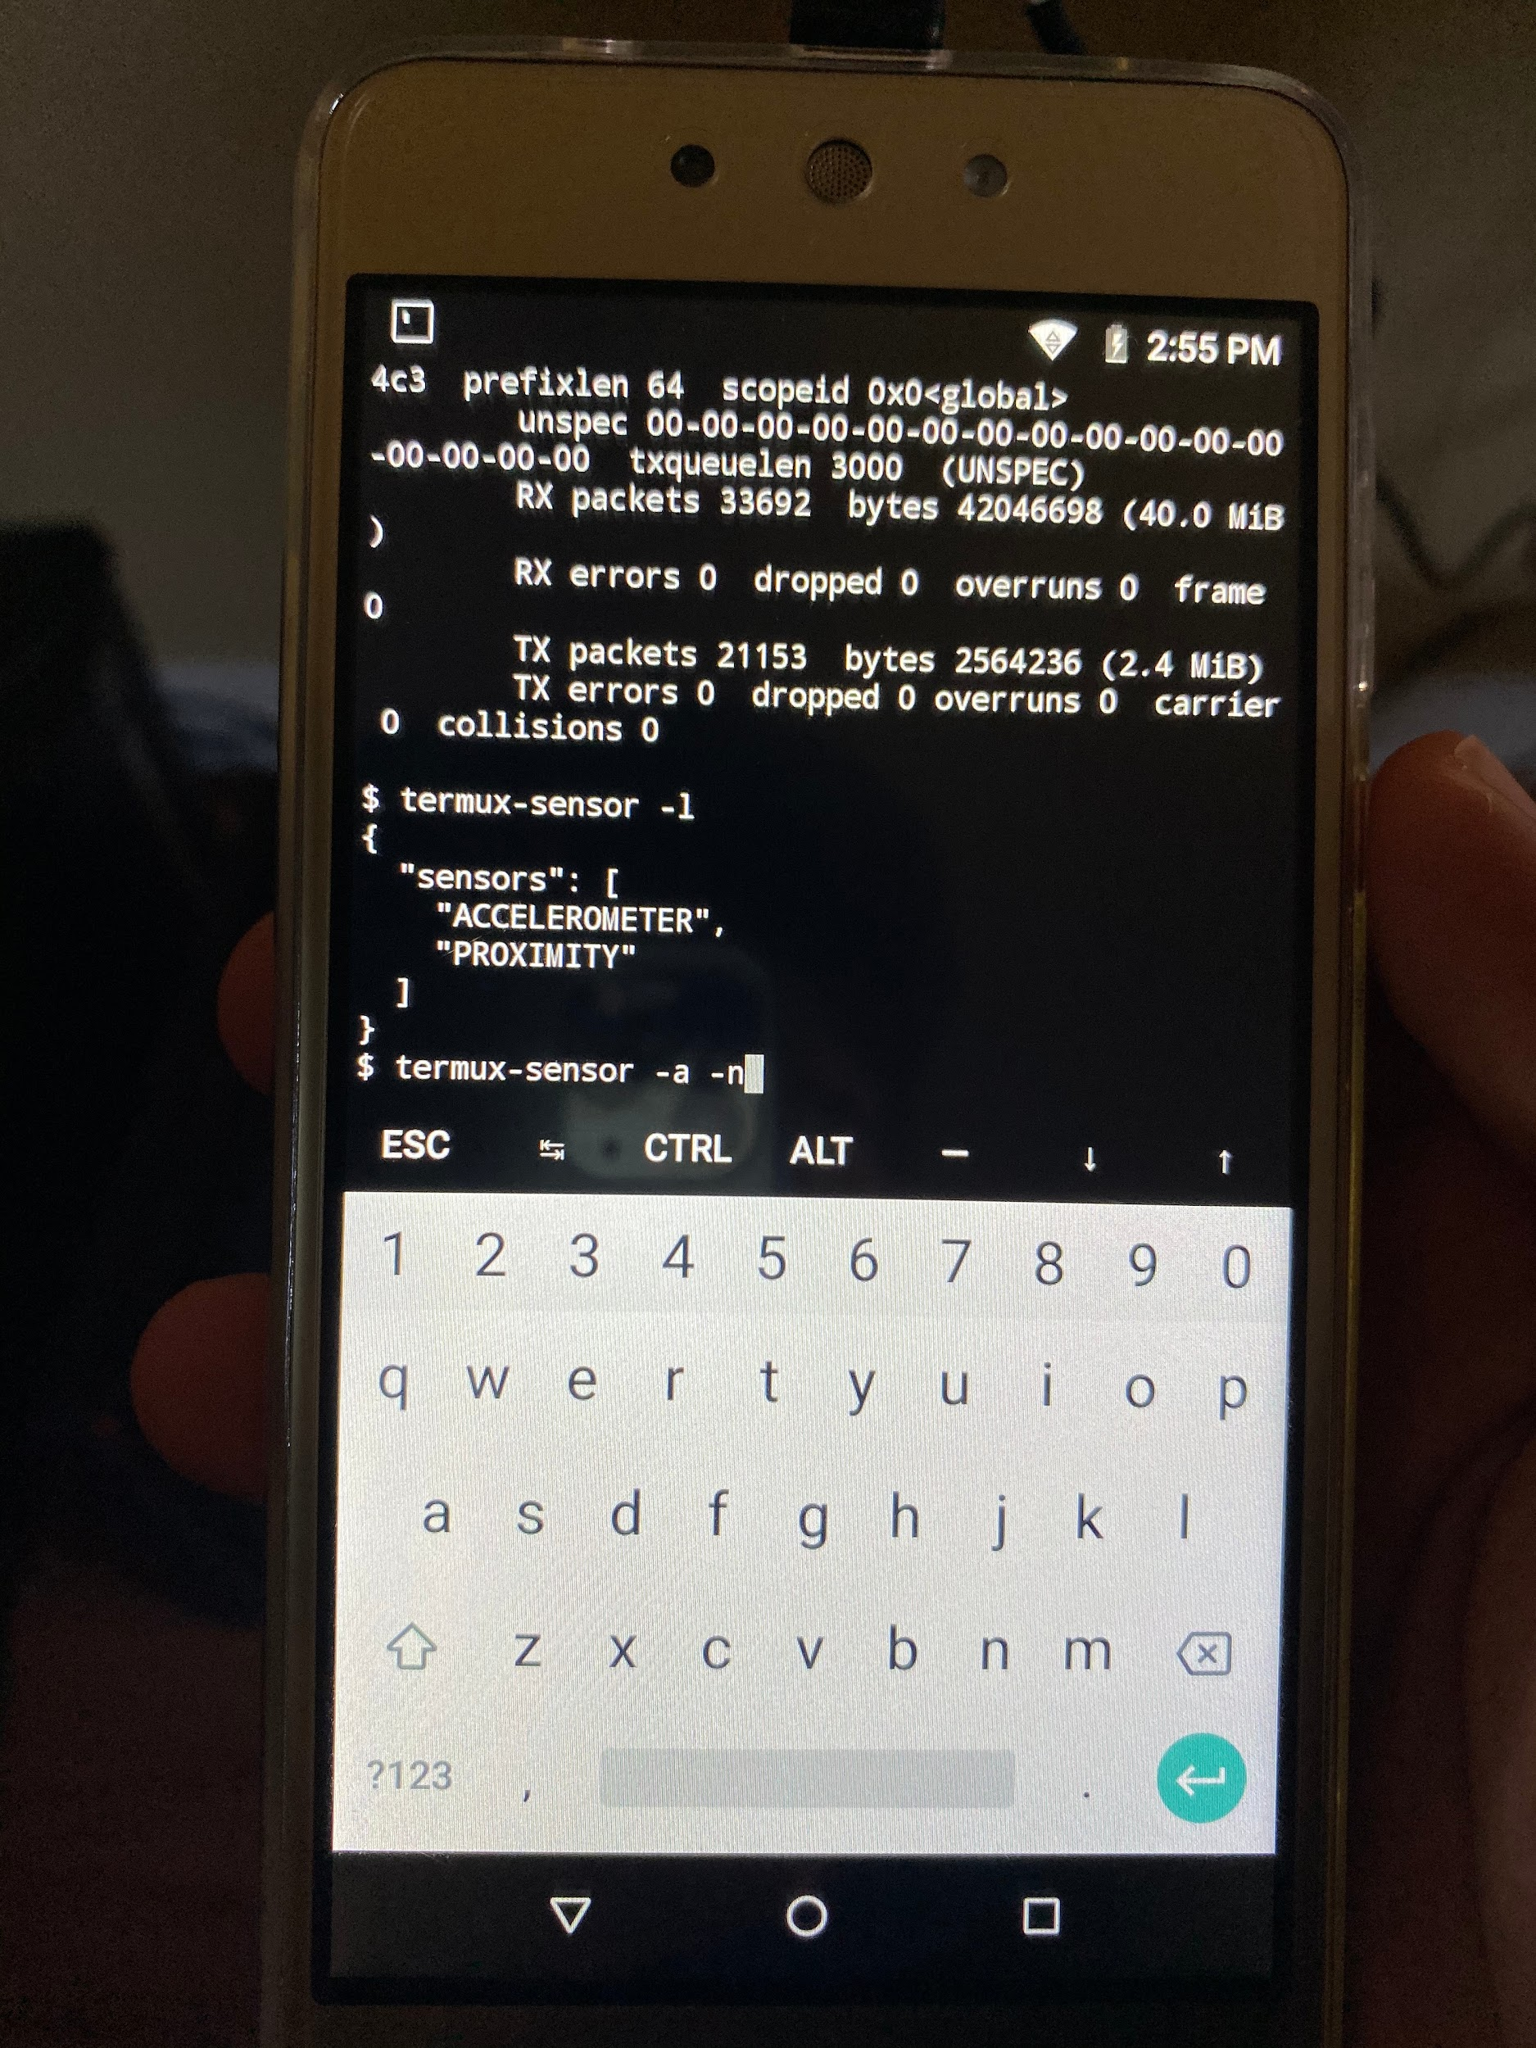
Step 4 and Step 5
→ After opening up the node-red you can swipe left to right on your top left screen to open a hamburger menu that allows you to create a new session. Create a new session and type in “termux-sensor -l” to view all available sensors. Our phone was crappy so, it only has two sensors.
→ You can filter for a specific sensor by typing
“Termux-sensor -s “NAME OF SENSOR””
By adding -n 1 to that command you can limit the
values displayed.

Slide 6
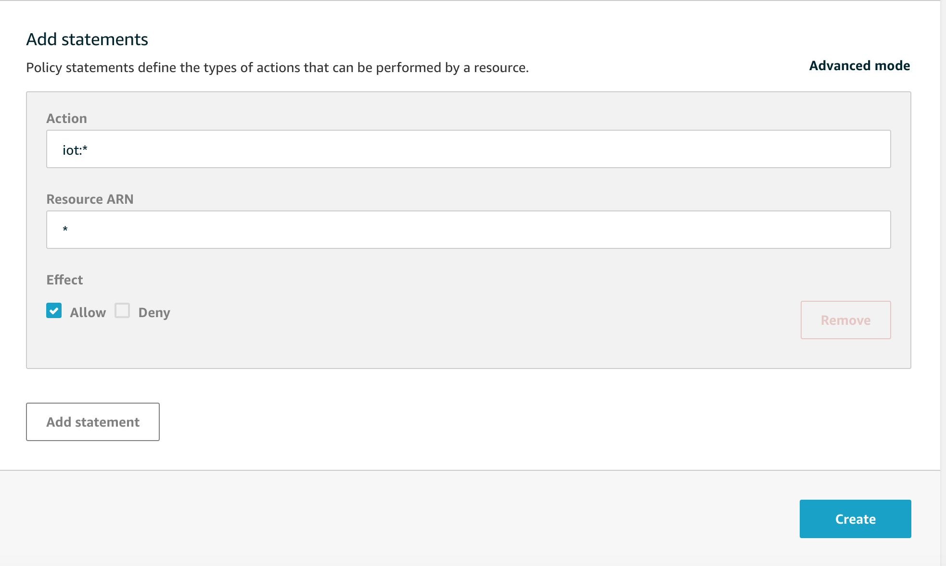
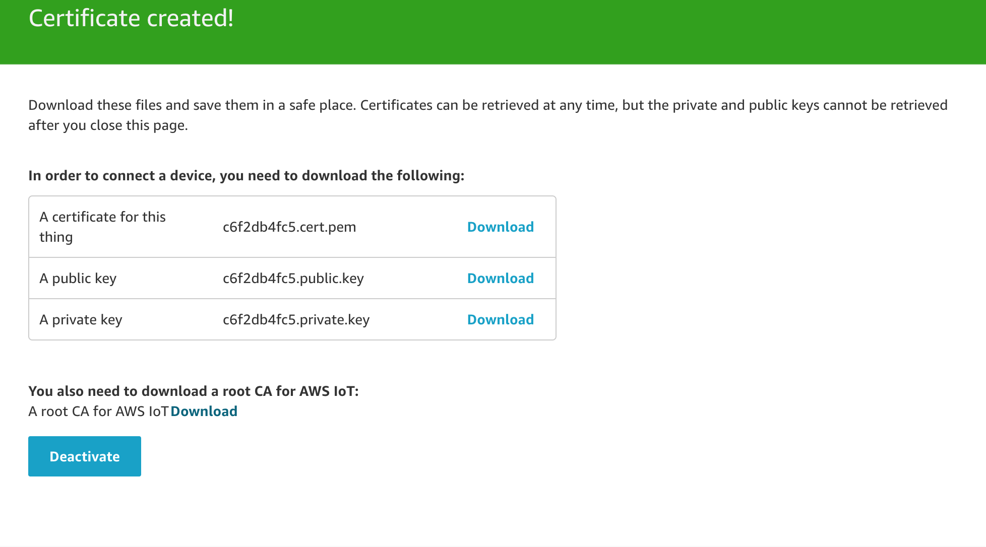
Step 6
→ Now, setting up AWS IoT. Log into AWS and navigate to IoT Core.
Secure>Policy>Create New Policy and insert values as seen on right and hit create.
Back in IoT core, Manage>Things>Create New Thing
When done with that, One-click Certificate Creation and download and ACTIVATE your certificates and keys. And remember to attach your policy to the thing.

Slide 7
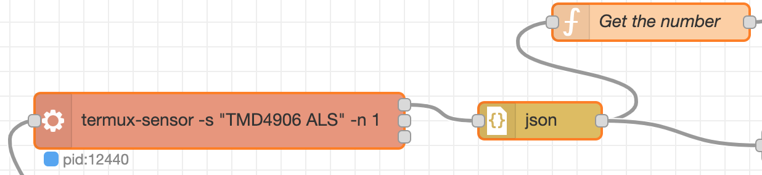
Step 7
→ Now we need to make sure the data is sending to AWS. In Node-Red, we need to create a flow.
→ In Node-Red, top right menu, import, Copy and paste code given in lab handout and import.
→ For the exec block write down the command for the sensor you want and change that value in the get the number function block.

Slide 8
Step 7 (cont…)
→ Now time to set up the http request with AWS. We need your custom endpoint URL found in IoT Core>Settings. Double click on http request block and now paste that URL into the URL block and append to it “:8443/topics/myTopic?qos=1”
→ Check the “Enable secure (SSL/TLS) connection” box and upload your certificates and keys downloaded from Step 6.
→ Hit Deploy and view your debug data from top right. Message must not be an error. If it’s not then navigate to IoT Core>Test and subscribe to myTopic and see the debug messages pop up in AWS.

Slide 9
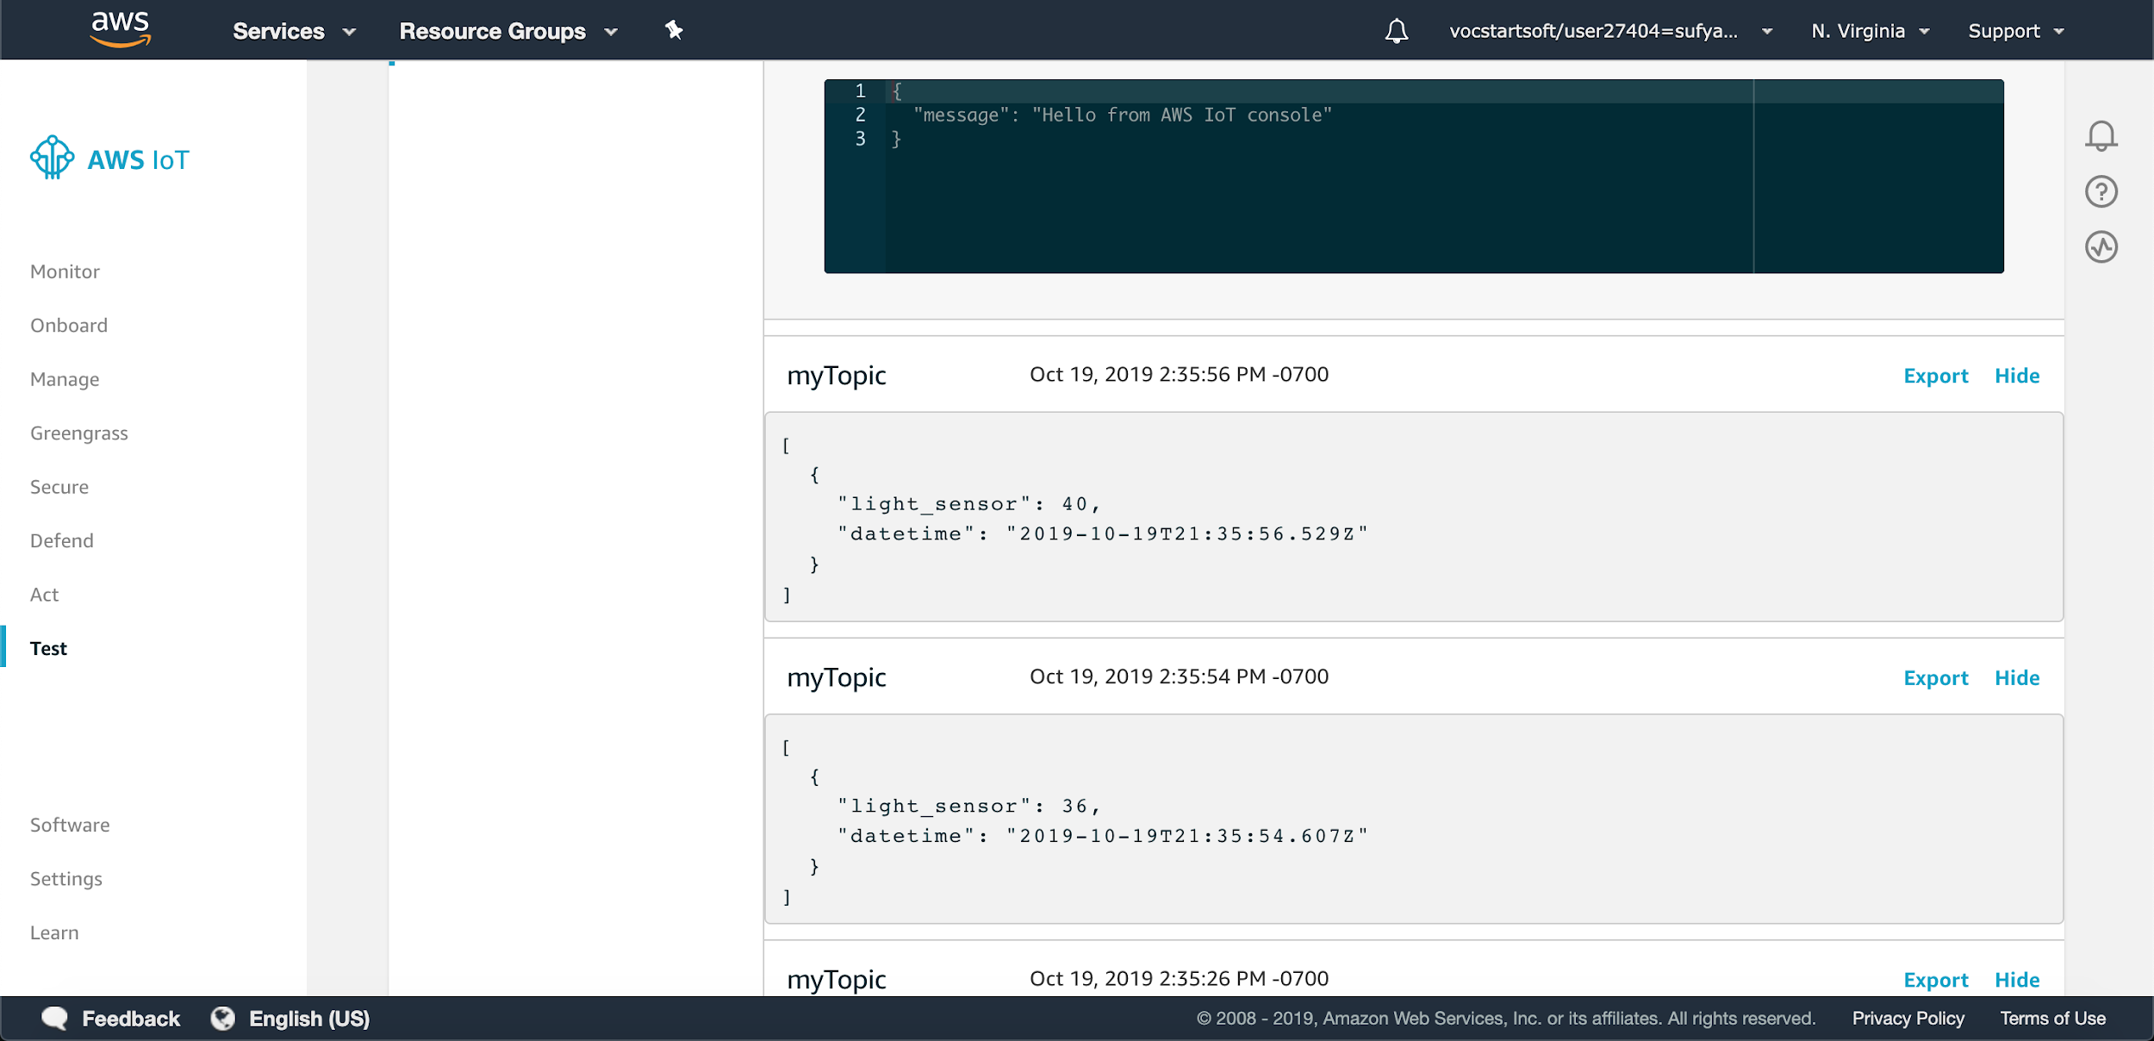

Slide 10
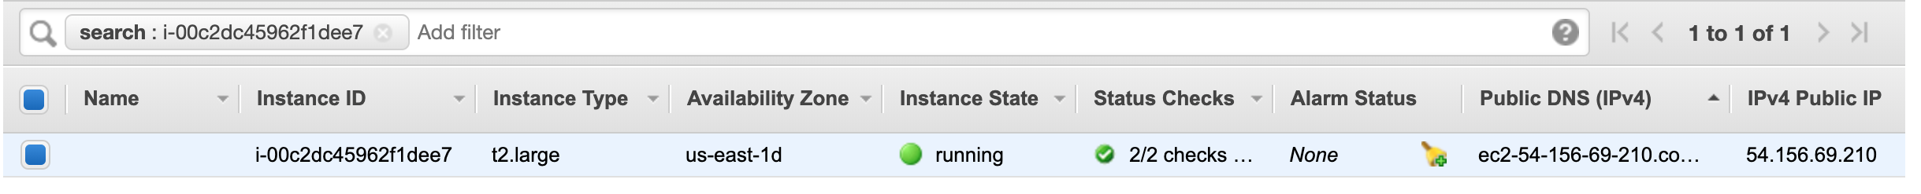
Step 8
→ Now time to visualize data using Thingsboard. Setup an EC2 instance, I used Linux.
→ SSH onto client and install Thingsboard. Guide to install can be found here:
https://thingsboard.io/docs/user-guide/install/installation-options/

Slide 11
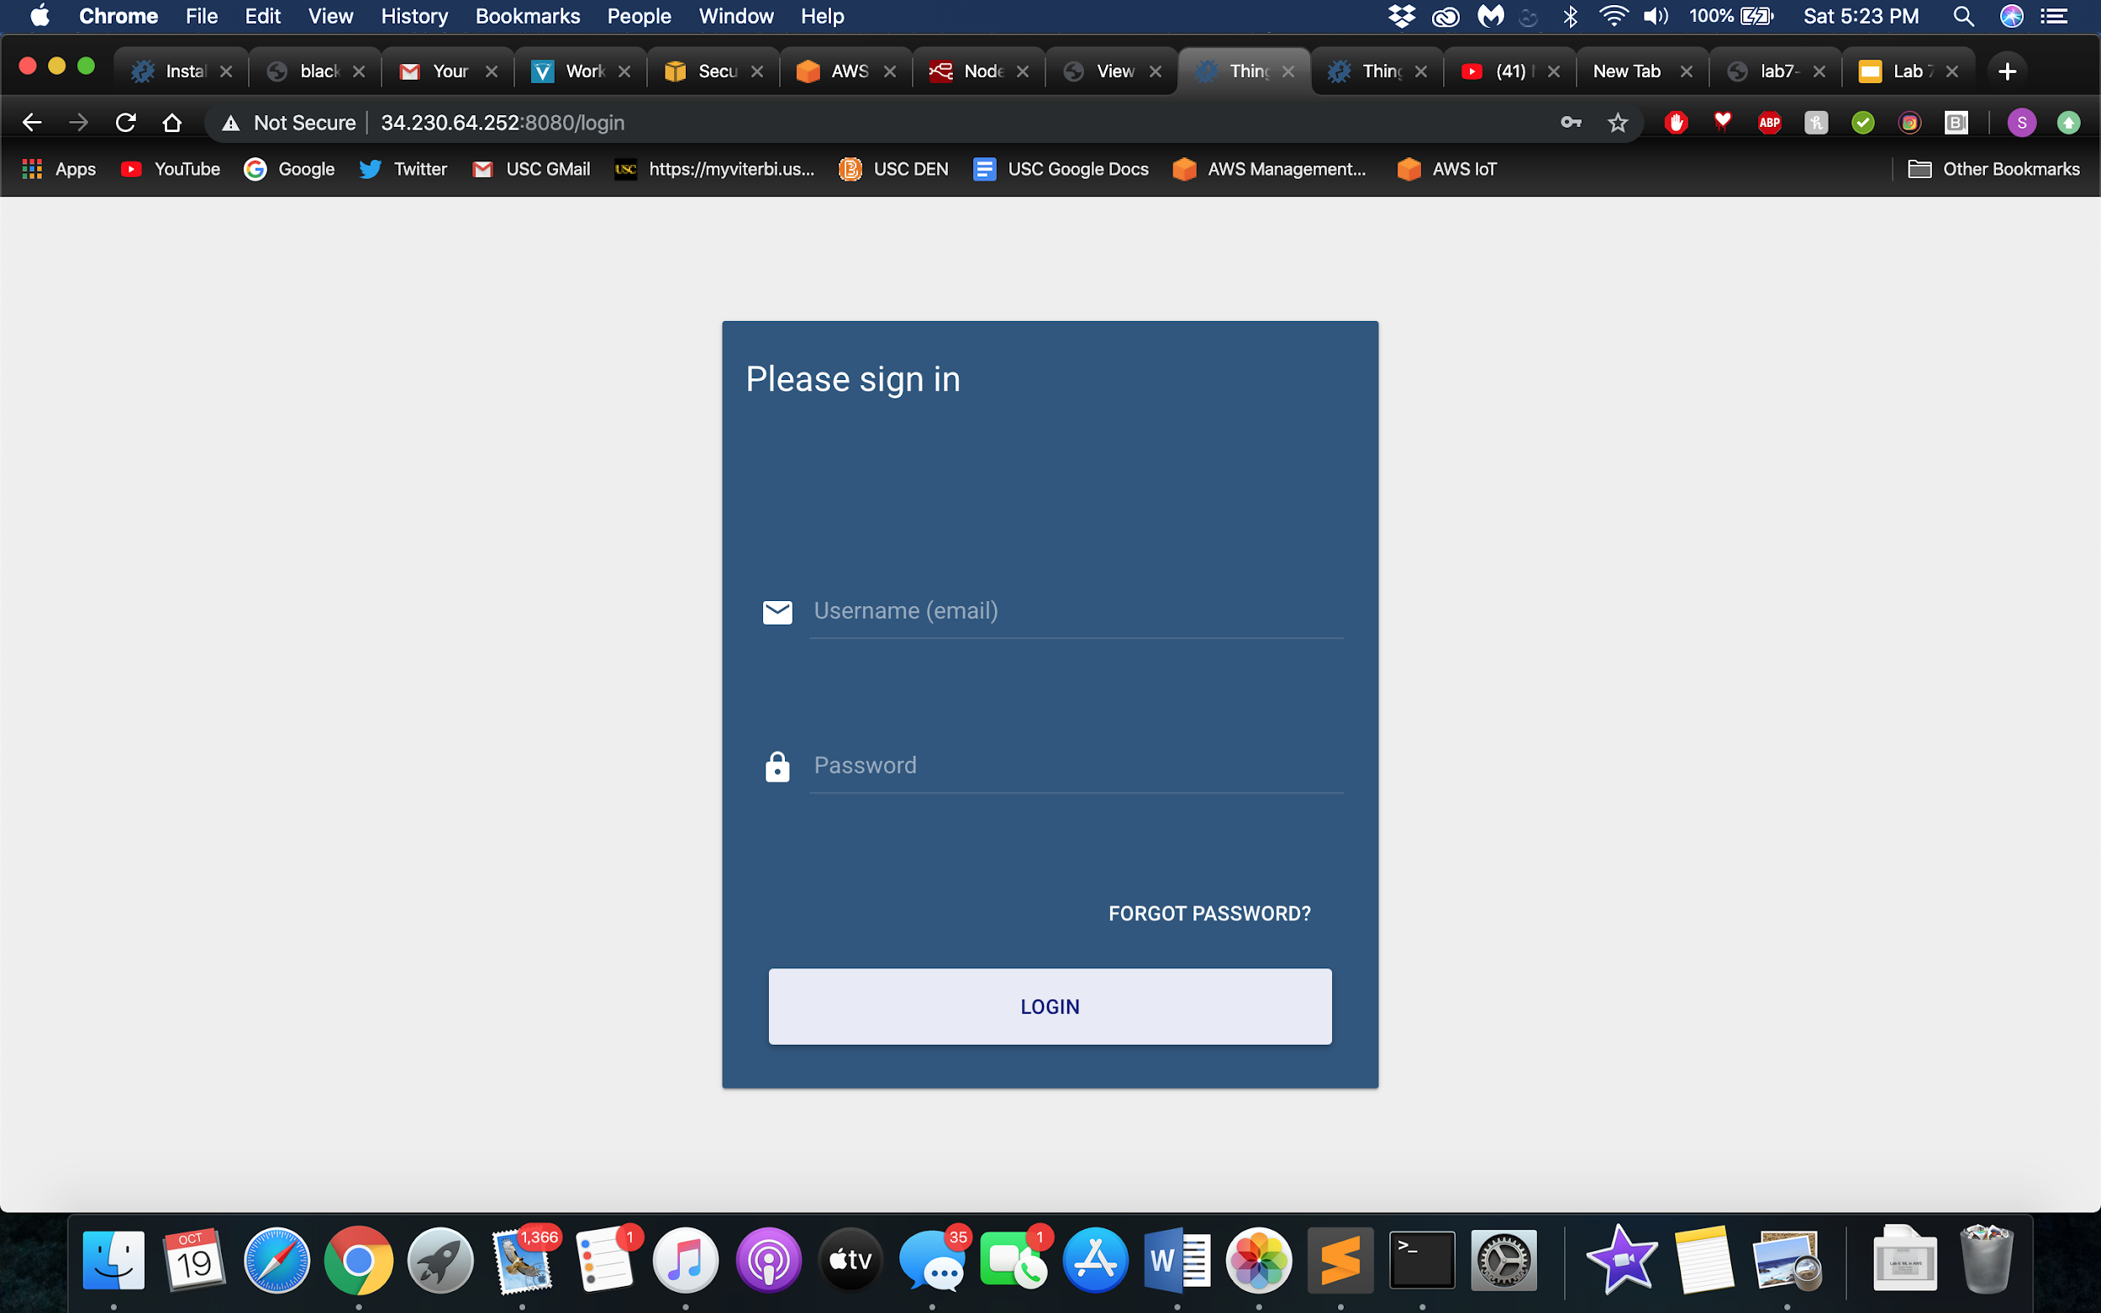
Step 8 (cont.)
→ After installing and starting Thingsboard, you should be able to navigate to this screen using your IP and port number 8080.
→ Login is tenant@thingsboard.com Password: tenant

Slide 12
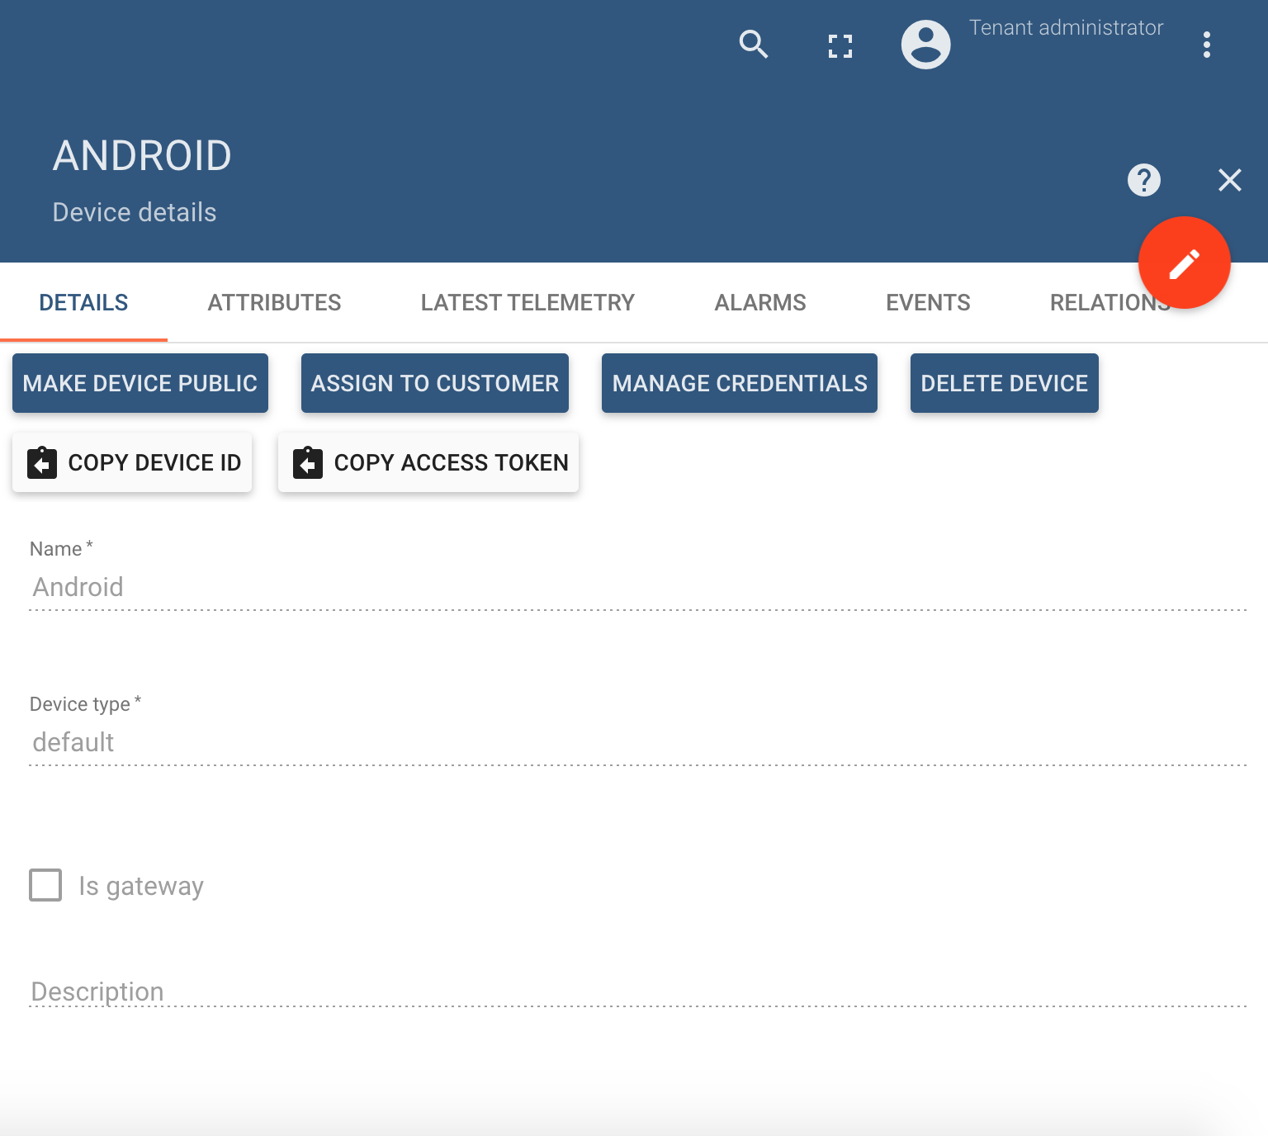
Step 8 (cont.)
→ Once logged in, Navigate to Devices. Add a device and name it android or whatever you want. It is of default type and NOT a gateway.
→ Copy the Access Token and put it in your
notes, you’re gonna need it for later.

Slide 13
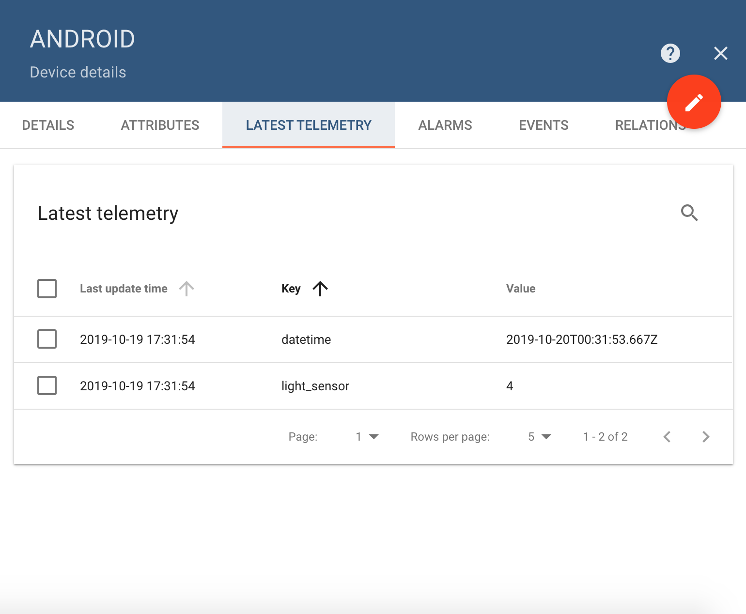
Step 8 (cont.)
→ You can now visualize the data in many ways. We chose to use Node-Red to do so. Create a new http-request block and it should be kept as POST.
→ In the URL, please type in “http://[IP_ADDR_OF_INSTANCE]:[PORT]/api/v1/$TOKEN/telemetry” ($TOKEN is the token you copied earlier)
→ Check back under your Android Device and you will see that under the telemetry tab, you have time and light_sensor data there.

Slide 14
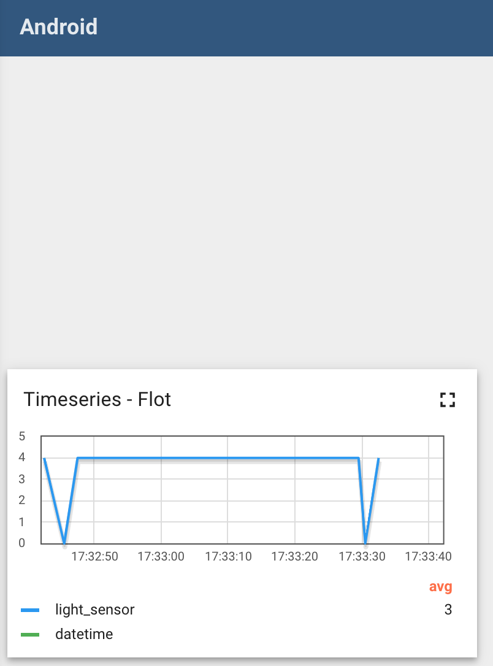
Step 8 (cont.)
→ By selecting the two boxes you can now plot the data and visualize it. I chose a timeseries flot.
→ On the next slide is a video of the chart in motion.

Slide 15
Step 8 short video of sensor visualization in action
https://www.youtube.com/watch?v=vLSE54DvhMA

